Slide 1
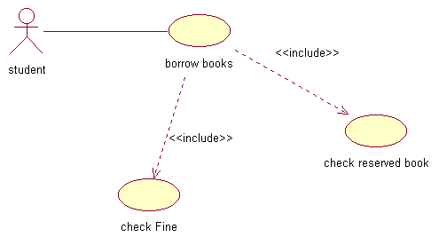
CPIS 443
Use Cases: Systematically Elaborating Requirements
Dr. Timothy Korson
Instructor

Slide 2
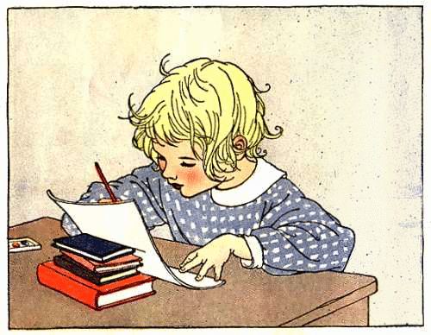
Topics
Use Cases
Models
Binary Decision Tables
Higher Order Decision Tables
OATS
State Transition Diagrams

Slide 3
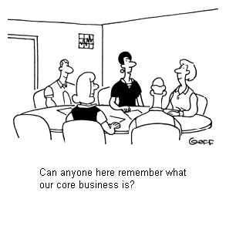
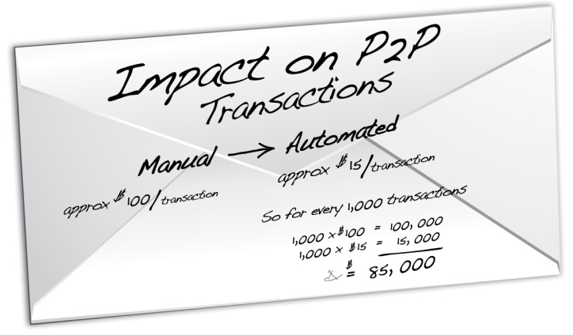
Requirements Come in All Shapes and Sizes

Slide 4
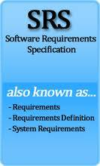
Could Be a Formal Document
Software Specification for the Remax Billing Project
Prepared by Jeff Webber, Mary Denmore, Chris Wall, and Rob Crandle
Version 1.2
1/387

Slide 5
Use cases and UML
Section 1

Slide 6
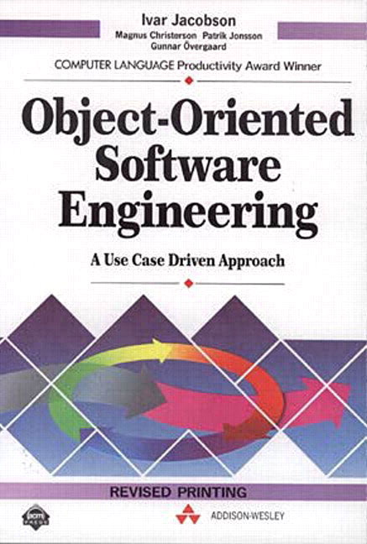
The Book that Started it All
Object-Oriented Software Engineering: A Use Case Driven Approach
by Ivar Jacobson
ISBN-10: 0201544350
Published in 1992

Slide 7
Timeline
1992
Object-Oriented Software Engineering: A Use Case Driven Approach
1994/5
Rumbaugh and Jacobson hired by Rational
1997
UML 1.0
1999
Rational Unified Process (RUP)
2003
Rational sold to IBM for 2.1B
UML 2.0
2010
UML 2.3 was formally released. UML 2.4 is in Beta

Slide 8
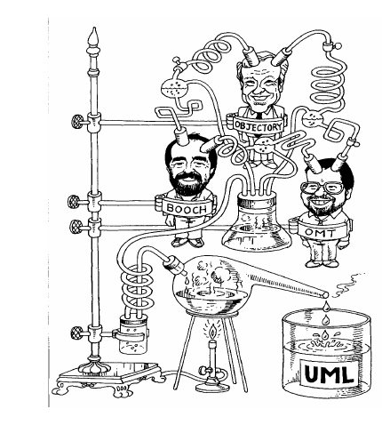
UML 1.0
Unified Modeling Language User Guide, (The Addison-Wesley Object Technology Series) by Grady Booch, James Rumbaugh, and Ivar Jacobson 1998
(2nd edition - May 29, 2005)

Slide 9
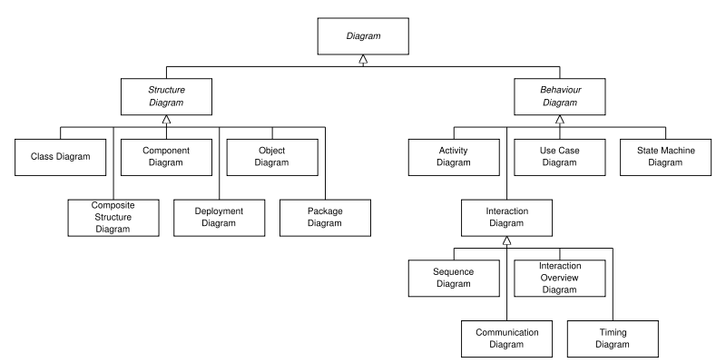
The Thirteen UML Diagrams

Slide 10
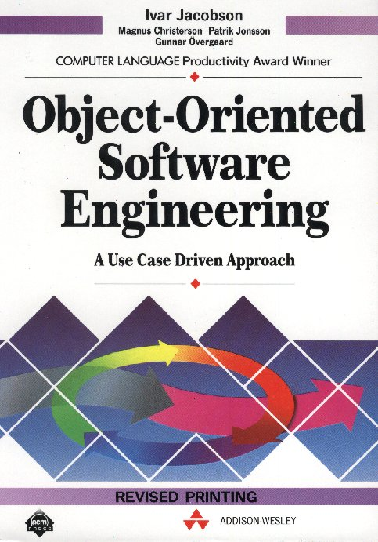
Definition by the Inventor
When an actor instance uses a system, it will perform a behaviorally related sequence of transactions with the system. We call such a sequence a use case. Jacobson

Slide 11
Use Case Definitions
Use Case. A collection of possible scenarios between the system under discussion and external actors, characterized by the goal the primary actor has toward the system’s declared responsibilities, showing how the primary actor’s goal might be delivered or might fail. Cockburn

Slide 12
My Use Case Definition
A goal related set of possible end to end interactions between a system and the users of that system. The documentation of a use case includes at a minimum
Identification of the primary actor role, any secondary actors, and any other stakeholders
Documentation of the goals of each of the stakeholders
Documentation of the system’s responsibilities during the interaction
A set of scenarios, both success and failure, showing the various interactions that could occur while trying to achieve the primary actor’s goal.
Pre and post-conditions for each scenario
Stakeholder provided risk analysis information
Cross references to related requirements documents

Slide 13
Use case?
The guest makes a reservation with the hotel. The hotel will take as many reservations as it has rooms available. When a guest arrives, he or she is processed by the registration clerk. The clerk will check the details provided by the guest with those that are already recorded. Sometimes guests do not make a reservation before they arrive. Some guests want to stay in non-smoking rooms.

Slide 14
Use Cases Model Interactions
A use case models the interactions between actor instances and a software system by using structured text.
A use case is a way of structuring and formatting textual interaction requirements.
Relationships between use cases can be shown graphically
Experience has shown the best way to structure and format use cases
Use a template that captures this experience

Slide 15
Use Case Example – Pick up Vehicle
Use Case ID: QRC.006
Use Case Type: Essential ; Level: Leaf
Use Case Name: Pick up vehicle
Actors/Stakeholders: Primary stakeholder is the renter, primary actor is the on-site agent, secondary stakeholder is homeland security
Goals: Renter’s goal is to take possession of appropriate type of car, and ensure that correct rental options (additional driver, insurance, gas options) apply to the rental. On-site agents goal is to make sure that the correct charges apply, validate drivers license, and get correct deposit. Homeland security wants to ensure that suspicious behavior is appropriately tracked or prevented.
Rationale: Most people rent a car because they have traveled away from home using public transportation and don’t have access to their own vehicle. Sometimes people rent a car if their own is in the repair shop, or they temporarily need or want a special type of vehicle – van, convertible, etc.
Cross Reference to Functional requirements: Homeland security document 35 section 14. QRC agent manual chapter 3.
Cross Reference to Quality Requirements: Security 12 section 4: credit card transactions,
Cross Reference to Business Rules: BR10.2 Rental rate table; BR10.4 credit card hold amounts; RB10.5 Cash deposit required

Slide 16
Use Case Example – Pick up Vehicle
Risk Analysis
Frequency: Differs by location, but averages out to 15 rentals per hour per location. We currently support 100 locations so the system must support 1500 rentals per hour.
Criticality: Very High. This is a core business function. All our revenue is tied to our ability to rent vehicles.
Complexity: the requirement are well known and stable, the technology required is tested and known, the user interface is not complex. Overall business complexity is low, so implementation risk is low, but note that criticality is Very High.
Overall Risk: 7
Basic Course:
Name: Successful pickup with credit card
Pre-conditions: appropriate car in stock, valid drivers license, valid credit card with sufficient credit available, renter not on watch list, renter is old enough, reservation exists.
Interactions: See page 2
Post-conditions: Renter has possession of car and contract, credit card has hold for appropriate amount, correct insurance , driver and gas options are in force, vehicle inventory adjusted, vehicle status set to rented
Alternative Success Courses: …
Alternative Failure Courses: …

Slide 17
Basic Course Interactions
Name: Successful pickup with credit cad
Reservation Agent | System
1. Retrieves existing reservation | 2. Displays reservation ; requests confirmation of drivers license info
3. Confirms license info | 4. Records confirmation and requests credit card info
5. Enters credit card information | 6. Validates credit card and places hold on account
7. Retrieves list of available vehicles | 8. Displays list of available vehicles
9. Selects vehicle | 10. Adjusts inventory and sets car status to rented
11. Selects options for insurance, gas, additional renters | 12. Records options, computes and displays charges
13. Requests printing of contract | 14 prints contract
Use case may end here or be extended by QRC 006e1 “check out of rental lot”

Slide 18
Alternate Success Course
Name: Successful pickup with cash
Pre-condition differences: no credit card needed, sufficient cash on hand
Post-condition differences: no credit card has hold , correct cash deposit taken
Frequency: Differs by location, but cash rentals averages out to 1 rental per day per location. We currently support 100 locations so the system must support 100 cash rentals per day.
Criticality: Same
Complexity: system must alert the agent to check for counterfeit bills.
Reservation Agent | System
5a1. Selects option to pay with cash | 6a1. system displays cash deposit required
5a2. Agent collects deposit and confirms with system that deposit has been collected | 6a2. system records deposit amount and acknowledges that correct cash deposit has been collected.
Alternate proceeds with basic course 7

Slide 19
Alternate Failure Course
Name: Credit card denied, insufficient cash on hand
Pre-condition differences: no valid credit card with sufficient credit available; insufficient cash on hand
Post-conditions: Renter not in possession of car and contract, no credit card hold , no insurance , driver and gas options are in force, vehicle inventory not adjusted, vehicle status left at available, Reservation cancelled.
Frequency: Differs by location, but denied credit cards average out to 1 reservation per week per location.
Criticality: Same
Complexity: denial could be due to incorrect data entry or worn magnetic strip
Reservation Agent | System
5. Enters credit card information | 6a1. System responds with “Credit Card Denied”
Steps 5 and 6a1 may be repeated as long as renter has additional credit card to try.
5a1. Agent verifies that renter has insufficient cash and cancels reservation | 6a2. System confirms cancelation of reservation
Alternate terminates

Slide 20
Pick up Vehicle - Concluded
Extensions: QRC.006 e1 “check out of rental lot”
Related Use Cases: QRC.005 “make reservation” often done prior to this use case, QRC.007“return vehicle” must be done after this. QRC.006e1“Check out of rental lot” required if location has a staffed check out gate.
---------------------------------------------------------------------------------------------------------------------
Modification History
Owner: Fred Banty
Initiation date: Jan 3, 2008
Date last modified:
Jan 07, 2008 – added precondition renter is old enough
Jan 16, 2008 – added alternate failure course: Credit card denied, insufficient cash on hand

Slide 21
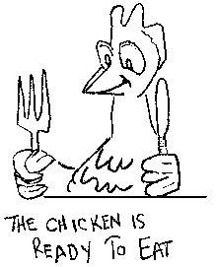
Natural Language
Ambiguous
Incomplete
Unstated assumptions

Slide 22
Models
Clarify ambiguous requirements
Identify missing requirements
Systematically identify test scenarios
Clarify
identify
test

Slide 23
Data
Model
Process
Model
Object
Model
Requirement Document in
Natural Language
State
Model
User
Interface
Model
Decision
Tables
Decision
Trees
Use
Cases

Slide 24
Binary Decision Table Example
Product in Stock | Y | Y | Y | Y | N | N | N | N
Sufficient money deposited | Y | Y | N | N | Y | Y | N | N
Correct Change Available | Y | N | Y | N | Y | N | Y | N
Effect
Dispense product and change | x
Out of Stock message |  |  |  |  | x | x | x | x
Add Money Message |  |  | x | x
Please Use Correct Change Message |  | x

Slide 25
Creating Non Binary Tables
Number of columns (test scenarios)
2^{n} where n = the number of causes
Populating the table
Bottom row: alternate “Yes/No” until all columns are filled
Each higher row: repeat “Yes” N times followed by “No” N times until all columns are filled
N is calculated as 2^{x} where X equals the number of rows under the current row.

Slide 26
Requirements to Scenarios
A customer can use cash to purchase a soda at the vending machine
Notes from conversation with the client: If product not in stock,
display out of stock message, otherwise if product in stock and
sufficient cash deposited then dispense product and change.
Otherwise if insufficient cash deposited display add money message

Slide 27
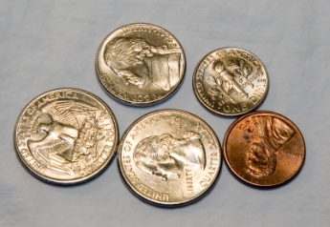
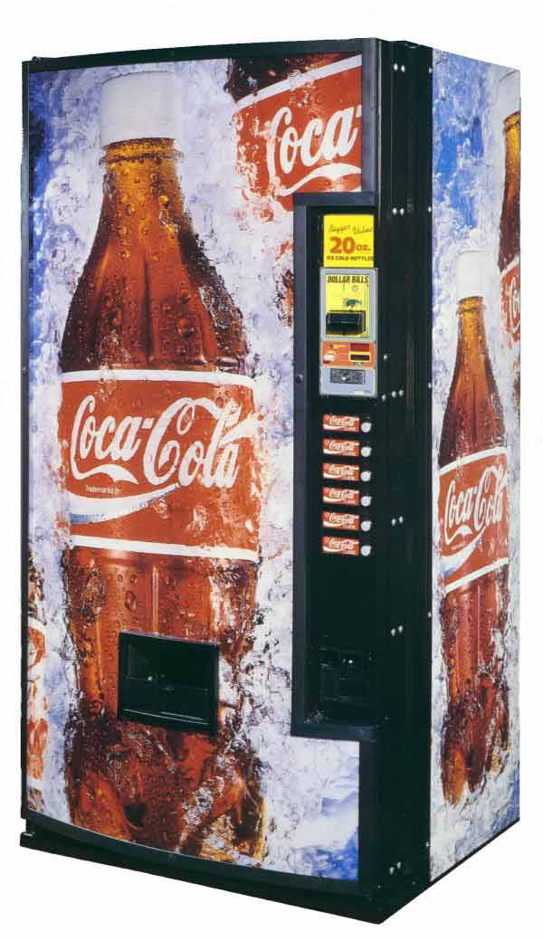
Test Cases
Input
Amount and type of cash
Preconditions
Stock level of product
Change available in machine

Slide 28
Decision Table
Product in Stock
Sufficient money deposited
Correct Change Available | Y | N | Y | N | Y | N | Y | N
Result
Dispense product and change
Out of Stock message
Add Money Message
Notes from conversation with the client: If product not in stock,
display out of stock message, otherwise if product in stock and
sufficient cash deposited then dispense product and change.
Otherwise if insufficient cash deposited display add money message

Slide 29
Decision Table
Product in Stock
Sufficient money deposited | Y | Y | N | N | Y | Y | N | N
Correct Change Available | Y | N | Y | N | Y | N | Y | N
Result
Dispense product and change
Out of Stock message
Add Money Message
Notes from conversation with the client: If product not in stock,
display out of stock message, otherwise if product in stock and
sufficient cash deposited then dispense product and change.
Otherwise if insufficient cash deposited display add money message

Slide 30
Decision Table
Product in Stock | Y | Y | Y | Y | N | N | N | N
Sufficient money deposited | Y | Y | N | N | Y | Y | N | N
Correct Change Available | Y | N | Y | N | Y | N | Y | N
Result
Dispense product and change
Out of Stock message
Add Money Message
Notes from conversation with the client: If product not in stock,
display out of stock message, otherwise if product in stock and
sufficient cash deposited then dispense product and change.
Otherwise if insufficient cash deposited display add money message

Slide 31
Decision Table
Product in Stock | Y | Y | Y | Y | N | N | N | N
Sufficient money deposited | Y | Y | N | N | Y | Y | N | N
Correct Change Available | Y | N | Y | N | Y | N | Y | N
Result
Dispense product and change
Out of Stock message |  |  |  |  | x | x | x | x
Add Money Message
Notes from conversation with the client: If product not in stock,
display out of stock message, otherwise if product in stock and
sufficient cash deposited then dispense product and change.
Otherwise if insufficient cash deposited display add money message

Slide 32
Decision Table
Product in Stock | Y | Y | Y | Y | N | N | N | N
Sufficient money deposited | Y | Y | N | N | Y | Y | N | N
Correct Change Available | Y | N | Y | N | Y | N | Y | N
Result
Dispense product and change | x
Out of Stock message |  |  |  |  | x | x | x | x
Add Money Message
Notes from conversation with the client: If product not in stock,
display out of stock message, otherwise if product in stock and
sufficient cash deposited then dispense product and change.
Otherwise if insufficient cash deposited display add money message

Slide 33
Decision Table
Product in Stock | Y | Y | Y | Y | N | N | N | N
Sufficient money deposited | Y | Y | N | N | Y | Y | N | N
Correct Change Available | Y | N | Y | N | Y | N | Y | N
Result
Dispense product and change | x
Out of Stock message |  |  |  |  | x | x | x | x
Add Money Message |  |  | x | x
Notes from conversation with the client: If product not in stock,
display out of stock message, otherwise if product in stock and
sufficient cash deposited then dispense product and change.
Otherwise if insufficient cash deposited display add money message

Slide 34
Decision Table
Product in Stock | Y | Y | Y | Y | N | N | N | N
Sufficient money deposited | Y | Y | N | N | Y | Y | N | N
Correct Change Available | Y | N | Y | N | Y | N | Y | N
Result
Dispense product and change | x
Out of Stock message |  |  |  |  | x | x | x | x
Add Money Message |  |  | x | x
Please Use Correct Change Message |  | x

Slide 35
You Try It
Program “Approve Loan”:
Input:
Credit rating between 300 and 900
Family income
Requirement:
If credit rating is 740 or higher, “loan approved” else if family income $100,000 or more “loan approved” else “loan disapproved”

Slide 36
Causes
Credit Rating 740 or higher | Y | Y | N | N
Income => $100,000 | Y | N | Y | N

Slide 37
Causes and Effects
Credit Rating 740 or higher | Y | Y | N | N
Income => $100,000 | Y | N | Y | N
Approve Loan | X | X | X
Disapprove Loan |  |  |  | X

Slide 38
Non Binary Tables
Code the possibilities for the causes
Income
L: < 100,000
H: >= 100,000
M: missing income (unemployed)
Credit Rating
L: less than 740
H: 740 or higher
M: Missing (insufficient history to get a credit rating)
How many test scenarios?

Slide 39
Creating Non Binary Tables
Number of columns (test scenarios)
Multiply together the number of possible values for each cause
Populating the table
Bottom row: alternate each possible value once until all columns are filled
Each higher row: repeat each possible value N times until all columns are filled
N is calculated by multiplying together the number of possible values for each row under the current row.

Slide 40
Building the Table
Credit
Income | H | L | M | H | L | M | H | L | M
Approve Loan
Disapprove Loan
Missing Income
Missing Credit

Slide 41
Building the Table
Credit | H | H | H | L | L | L | M | M | M
Income | H | L | M | H | L | M | H | L | M
Approve Loan
Disapprove Loan
Missing Income
Missing Credit

Slide 42
Using the Requirements to Complete the Table
Credit | H | H | H | L | L | L | M | M | M
Income | H | L | M | H | L | M | H | L | M
Approve Loan | X | X | X? | X |  |  | X?
Disapprove Loan |  |  |  |  | X | X? |  | X?
Missing Income |  |  |  |  |  |  |  |  | X
Missing Credit |  |  |  |  |  |  |  |  | X

Slide 43
Validating the Table with the Stakeholders
Credit | H | H | H | L | L | L | M | M | M
Income | H | L | M | H | L | M | H | L | M
Approve Loan | X | X | X | X
Disapprove Loan |  |  |  |  | X | X
Missing Income |  |  |  |  |  |  |  |  | X
Missing Credit |  |  |  |  |  |  | X | X | X

Slide 44
Populating Non-Binary Tables More Examples
Repeat value | number of values | Possible values | Causes | 1 | 2 | 3 | 4 | 5 | 6 | 7 | 8 | 9 | 10 | 11 | 12 | 13 | 14 | 15 | 16 | 17 | 18 | 19 | 20 | 21 | 22 | 23 | 24
12 | 2 | Yes, No | Senior | y | y | y | y | y | y | y | y | y | y | y | y | n | n | n | n | n | n | n | n | n | n | n | n
3 | 4 | Silver, Gold, Plat, Dia | FF Status | s | s | s | g | g | g | p | p | p | d | d | d | s | s | s | g | g | g | p | p | p | d | d | d
1 | 3 | Coach, First, Business | Class | c | f | b | c | f | b | c | f | b | c | f | b | c | f | b | c | f | b | c | f | b | c | f | b
8 | 3 | Chick, Beef, Fish | Meat | c | c | c | c | c | c | c | c | b | b | b | b | b | b | b | b | f | f | f | f | f | f | f | f
4 | 2 | Brocc, spinach | Veg | B | B | B | B | s | s | s | s | B | B | B | B | s | s | s | s | B | B | B | B | s | s | s | s
2 | 2 | Potato, Spaghetti | Starch | P | P | S | S | P | P | S | S | P | P | S | S | P | P | S | S | P | P | S | S | P | P | S | S
1 | 2 | Water, Tea | Drink | W | T | W | T | W | T | W | T | W | T | W | T | W | T | W | T | W | T | W | T | W | T | W | T
6 | 3 | Summer, Xmas, Spring | When | s | s | s | s | s | s | x | x | x | x | x | x | sp | sp | sp | sp | sp | sp
3 | 2 | parents, Disney | Destination | p | p | p | d | d | d | p | p | p | d | d | d | p | p | p | d | d | d
1 | 3 | car, plane, train | travel | c | p | t | c | p | t | c | p | t | c | p | t | c | p | t | c | p | t

Slide 45
You Try it
Three causes
Own their own home
Yes
No
Income
L: < 100,000
H: >= 100,000
M: missing income (unemployed)
Credit Rating
L: less than 740
H: 740 or higher
M: Missing (insufficient history to get a credit rating)
How many test scenarios?

Slide 46
18 Scenarios
Scenario | 1 | 2 | 3 | 4 | 5 | 6 | 7 | 8 | 9 | 10 | 11 | 12 | 13 | 14 | 15 | 16 | 17 | 18
Own
Credit
Income | H | L | M | H | L | M | H | L | M | H | L | M | H | L | M | H | L | M
Approve
Disapprove
Missing Income
Missing Credit

Slide 47
18 Scenarios
Scenario | 1 | 2 | 3 | 4 | 5 | 6 | 7 | 8 | 9 | 10 | 11 | 12 | 13 | 14 | 15 | 16 | 17 | 18
Own
Credit | H | H | H
Income | H | L | M | H | L | M | H | L | M | H | L | M | H | L | M | H | L | M
Approve
Disapprove
Missing Income
Missing Credit

Slide 48
18 Scenarios
Scenario | 1 | 2 | 3 | 4 | 5 | 6 | 7 | 8 | 9 | 10 | 11 | 12 | 13 | 14 | 15 | 16 | 17 | 18
Own
Credit | H | H | H | L | L | L
Income | H | L | M | H | L | M | H | L | M | H | L | M | H | L | M | H | L | M
Approve
Disapprove
Missing Income
Missing Credit

Slide 49
18 Scenarios
Scenario | 1 | 2 | 3 | 4 | 5 | 6 | 7 | 8 | 9 | 10 | 11 | 12 | 13 | 14 | 15 | 16 | 17 | 18
Own
Credit | H | H | H | L | L | L | M | M | M
Income | H | L | M | H | L | M | H | L | M | H | L | M | H | L | M | H | L | M
Approve
Disapprove
Missing Income
Missing Credit

Slide 50
18 Scenarios
Scenario | 1 | 2 | 3 | 4 | 5 | 6 | 7 | 8 | 9 | 10 | 11 | 12 | 13 | 14 | 15 | 16 | 17 | 18
Own
Credit | H | H | H | L | L | L | M | M | M | H | H | H | L | L | L | M | M | M
Income | H | L | M | H | L | M | H | L | M | H | L | M | H | L | M | H | L | M
Approve
Disapprove
Missing Income
Missing Credit

Slide 51
18 Scenarios
Scenario | 1 | 2 | 3 | 4 | 5 | 6 | 7 | 8 | 9 | 10 | 11 | 12 | 13 | 14 | 15 | 16 | 17 | 18
Own | Y | Y | Y | Y | Y | Y | Y | Y | Y
Credit | H | H | H | L | L | L | M | M | M | H | H | H | L | L | L | M | M | M
Income | H | L | M | H | L | M | H | L | M | H | L | M | H | L | M | H | L | M
Approve
Disapprove
Missing Income
Missing Credit

Slide 52
18 Scenarios
Scenario | 1 | 2 | 3 | 4 | 5 | 6 | 7 | 8 | 9 | 10 | 11 | 12 | 13 | 14 | 15 | 16 | 17 | 18
Own | Y | Y | Y | Y | Y | Y | Y | Y | Y | N | N | N | N | N | N | N | N | N
Credit | H | H | H | L | L | L | M | M | M | H | H | H | L | L | L | M | M | M
Income | H | L | M | H | L | M | H | L | M | H | L | M | H | L | M | H | L | M
Approve
Disapprove
Missing Income
Missing Credit

Slide 53
18 Scenarios
Scenario | 1 | 2 | 3 | 4 | 5 | 6 | 7 | 8 | 9 | 10 | 11 | 12 | 13 | 14 | 15 | 16 | 17 | 18
Own | Y | Y | Y | Y | Y | Y | Y | Y | Y | N | N | N | N | N | N | N | N | N
Credit | H | H | H | L | L | L | M | M | M | H | H | H | L | L | L | M | M | M
Income | H | L | M | H | L | M | H | L | M | H | L | M | H | L | M | H | L | M
Approve | x |  | x | x |  |  | x |  |  | x |  | x |  |  |  | x
Disapprove |  | x |  |  | x | x |  | x |  |  | x |  | x | x | x |  | x
Missing Income |  |  |  |  |  |  |  |  | x |  |  |  |  |  |  |  |  | x
Missing Credit |  |  |  |  |  |  |  |  | x |  |  |  |  |  |  |  |  | x

Slide 54
State Transition Diagrams
Another Way to Clarify Requirements and Systematically Find Test Scenarios

Slide 55
Many Systems Have States
Consider the Reservation process in an airline reservation system
How many scenarios?

Slide 56
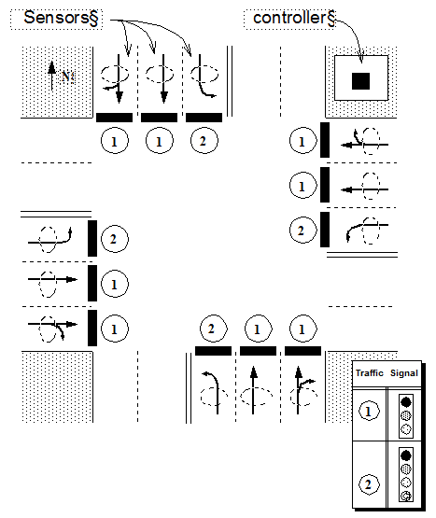
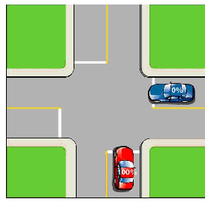
Standard Four Way Intersection

Slide 57
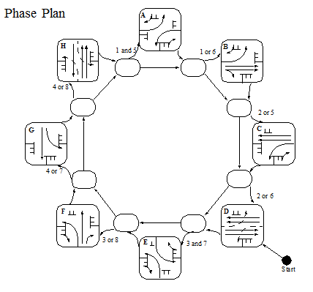
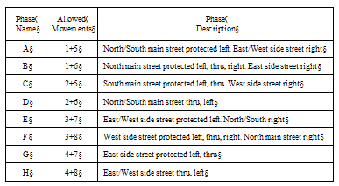
Lee Hwy at Shallowford Road Signal Plan
City of Chattanooga Traffic Engineering Division
Eight Phase, Actuated, Left-lead, Phase Plan
This would be a nightmare to specify in unstructured English text!

Slide 58
How Many Scenarios?

